Slide 1
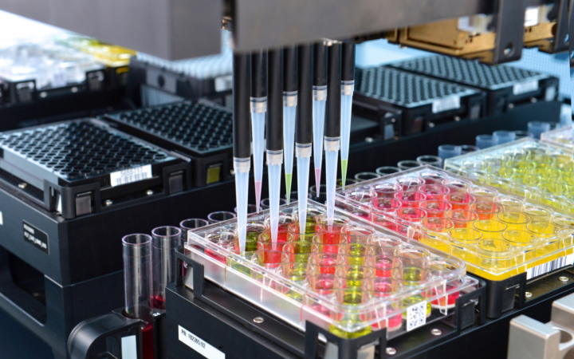


Process Laboratory Workflow
Team Mövenpick
Notes:
I’m pleased to welcome you to our presentation,
we are going to talk about processes and opportunities for data integration in a clinical laboratory

Slide 2

Team: Mövenpick
Selina Hodel
Sascha Fossard
Marvin Marquard
Denis Moser

Slide 3
Project
Real-life process in the MTP Lab at USZ
Genetic cancer diagnostics and research
Goals:
Analyze AS-IS, “dead ends”
Reduce user tasks
Improve overall order management process
Procedure:
Review "Order Report" process
Model AS-IS
Model TO-BE
Implementation of a section in the TO-BE
Tools:
Camunda (Modelling, Workflow Engine), Make, Deepnote, Google Sheets
Notes:
About our project scope.
We looked at a real-life process in the MTP Lab at the University Hospital in Zürich.
MTP is a Facility specialized in molecular tumor profiling,... it provides genetic tests for internal and external clients in the field of research and diagnostics.
Our main goals were to:
To Analyze the as-is situation in order to figure out if any problem are present, for example if there are "dead-ends"
To identify and reduce unnessessary user tasks
And overall to improve the order management process.
For this we did following steps:
We Reviewed the current “Order Report” Process
Then we modelled the AS-IS Process to identify challenges and opportunities
Then we modelled the TO-BE Process
And finally we chose a section within the TO-BE, and implemented a workflow with some improvements
The Tools were
Camunda we for modelling and the workflow engine,

Slide 4
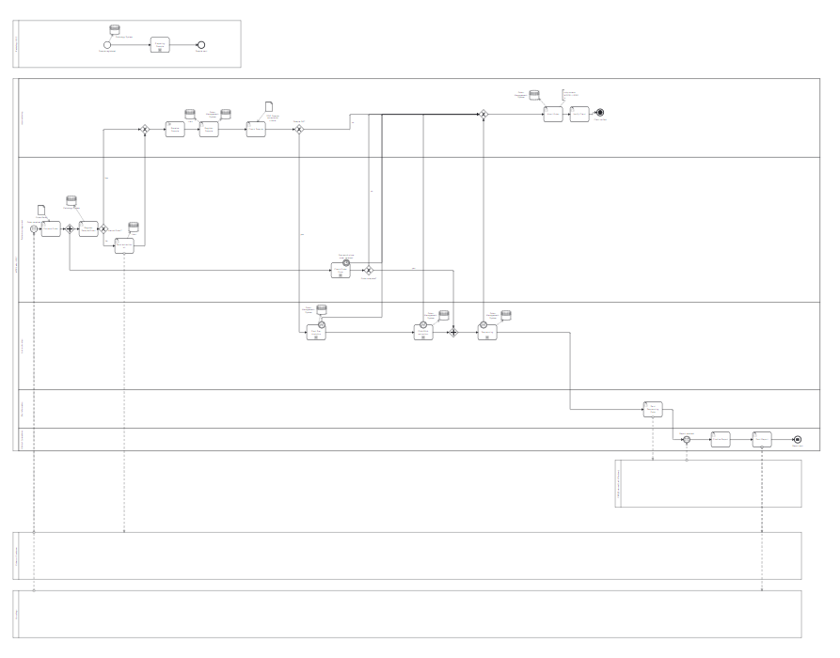


AS-IS
post
pre
analytical
Complexity
Multiple Lanes
Several information systems
Challenges:
Manual work: tasks, data entry
Forms, sample quality checks
Opportunities:
Automatization, integration
Digital forms
Automated dispatch of customer mail
Order MGMT
LIMS
Patho
Notes:
The AS-IS situation is quite complex:…..
but the whole lab process can roughly be devided (*) in preanalytical, analytical and post analytical stage.
Those encompass different Actors and Facilities and different Information Systems as well (**)
And there lies one of the main challenges:
- Currently,(***) they manually ensure data consistency, which is prone to errors and time-consuming as well-
- second to that, in the whole process there are several tasks in which certain conditions must be met, for example sample quality checks. If they aren’t ok the whole process needs to be aborted.
Opportunities:
- automatization, and integration... informations systems to ensure data consistency
- one opportunities lies in the digitalization of a Quality-Check-List, which they currently use to cross-check the bio-Sample against paper based Criteria
- and lastly they could use an automated dispacht of email informing customer if the process had to be aborted. To tackle those point we modelled the TO-BE, which Marvin will elaborate further....

Slide 5
To-BE Process

Slide 6
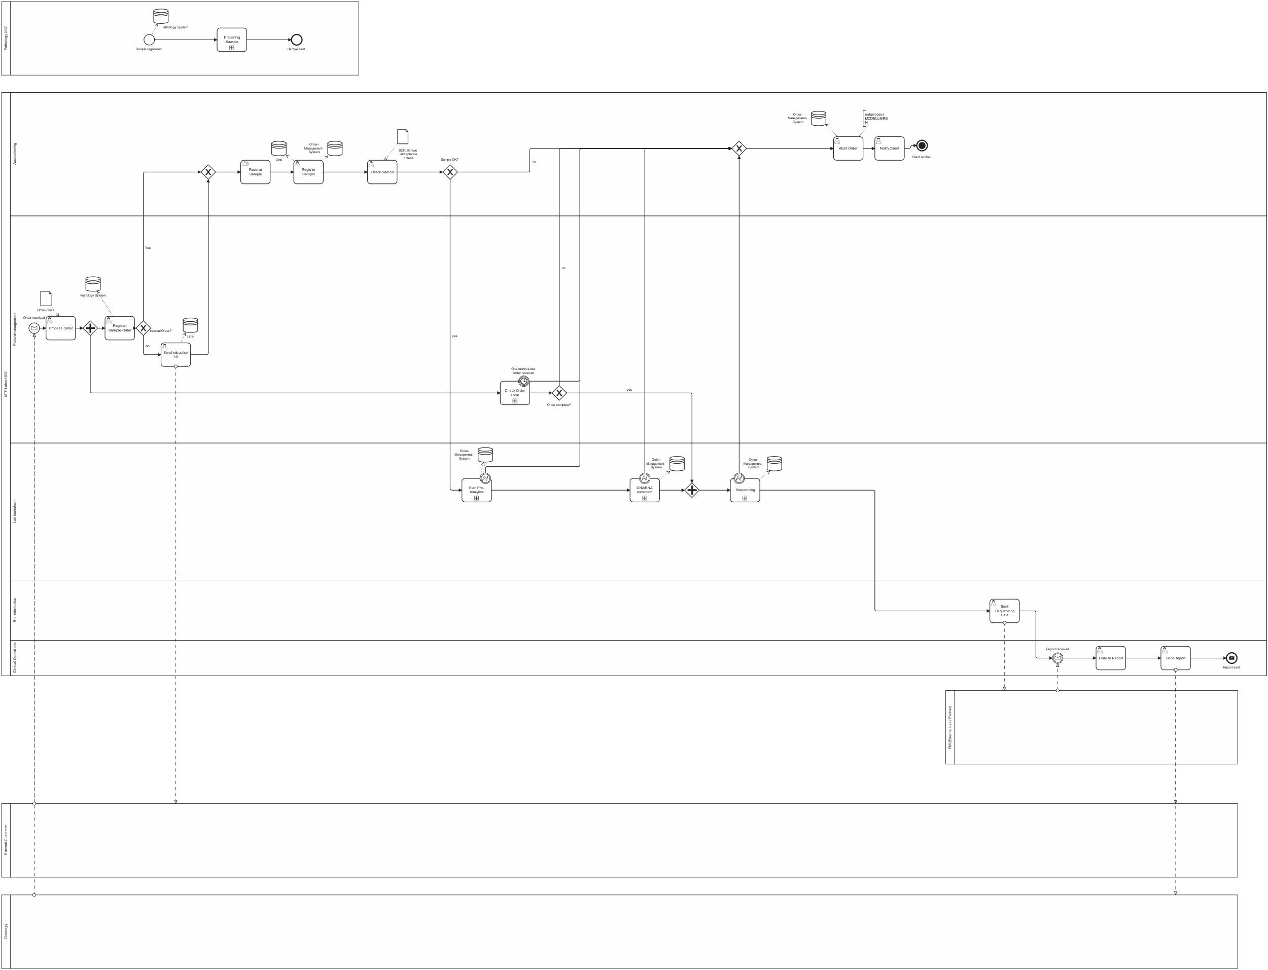
To-be-Process Focus

Slide 7
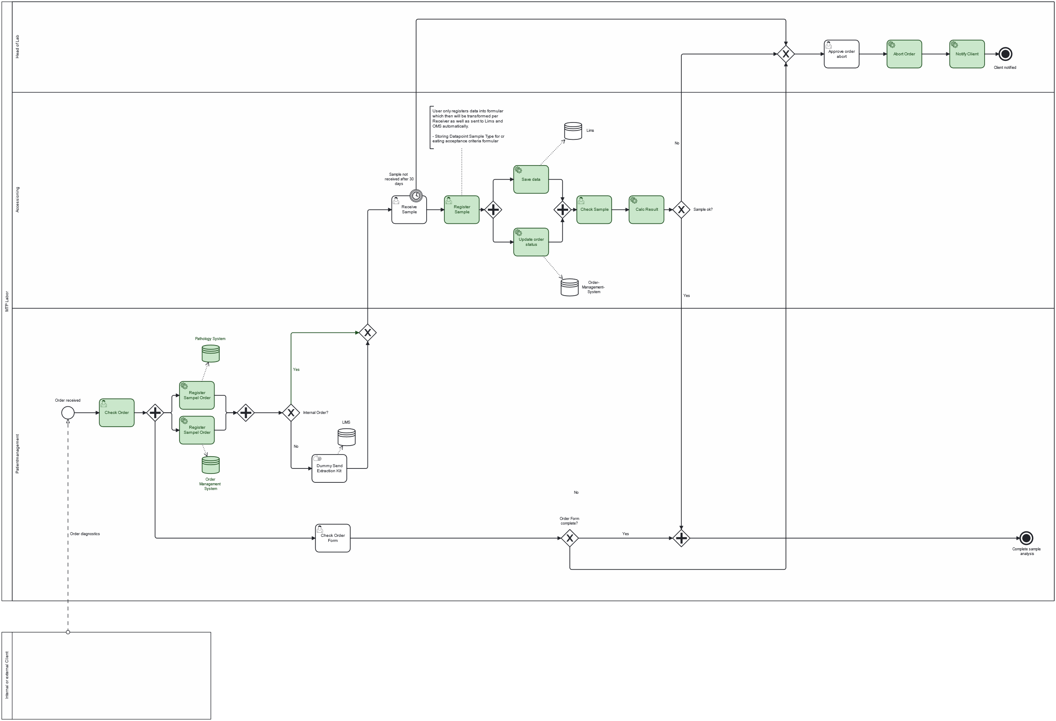
Developed process based on focus

Slide 8

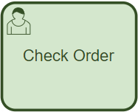
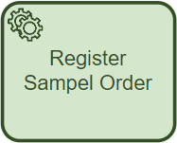

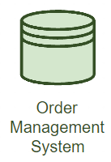




API-Call POST
Implementation Order Entry
Order Entry
HTTP
POST
API Call
Add ROW
Notes:
The Process starts with receiving an order for genetic analysis: here on top is the simplified version, we have
- Order received is the start event
- Check Order Order In this user task the user checks the order for important informations. And assigns process variables via Form (orderId, sampleId, the customerEmail, and orderInternal (which contains the information if the order is internal or external).
Register Sample Order we made two service tasks, which send data to Pathology and Ordermanagement Informationsystem
We made it so that in Camunda we used JavaScript to format the data payload for a POST-Request via HTTP connector. This call goes to a webhook, which triggers a make scenario.
In make the data is put into a Google Sheet, which simulates the Databases of the Informationssystems we are talking to. And the process goes to the next step…

Slide 9
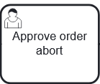
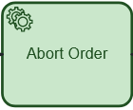



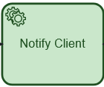


Implementation Abort
Search Row
Update Row
Order Abort
Join Gateway
Failure
Reason
Send Email
Terminate
End Event
Notes:
Throughout the course of the process, there are various instances where an order may need to be aborted. These include:
- that client does not provide all the necessary information for order form completion, there is missing data
- samples are not accepted due to failure of meeting criteria defined in SOP.
-or the sample is not received for more than 30 days after the order was placed.
If a reason to abort the order occurs, the process transitions to the user task 'approve order abort.' The lab's head assesses the validity of the abortion and adjusts the automatically passed failure reason if necessary.
Once the validation is complete and the lab head approved the cancellation of the order.
A service task is initiated in make via webhook. This scenario automatically updates the orderStatus of the corresponding order in the Order Management system simulated in our google sheet and sets it to aborted.
The next step in the process is a service task to notify the customer. And is also a make scenario triggered via webhook. It passes in the failureReason, emailAdress of customer and orderID as well as sampleID. An automatically generated Email is then sent to the customer. After completion of this task the whole process instance is terminated via terminate end event.

Slide 10
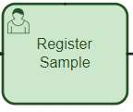

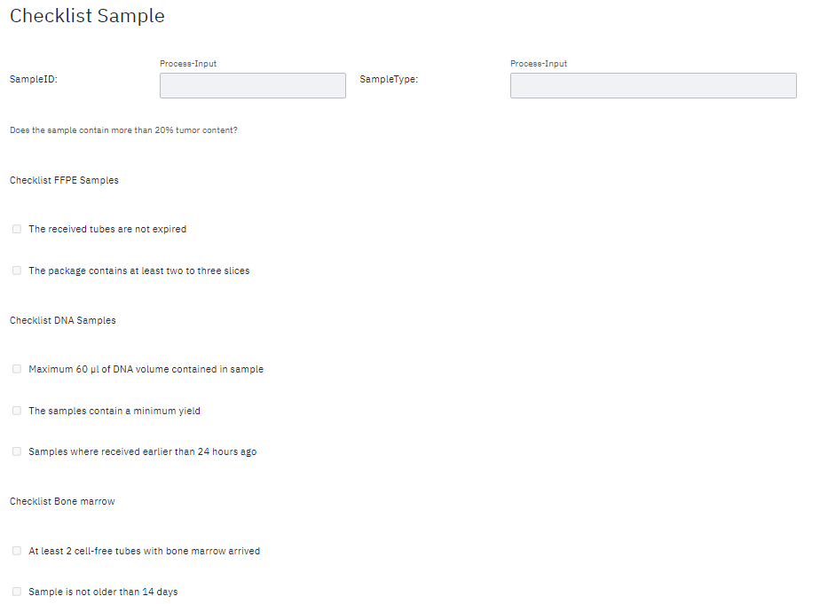
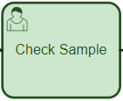
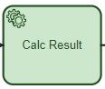

Implementation Register/Check-Sample
Register-Sample
HTTP-Request
API-Call
Check Sample & Calculate Result
DNA
timeOK,
volumeOK,
yieldOK,
…,
…
Topic
Bone m.
publish
subscribe
External Task
FFPE
Notes:
- Center of our tobe-process is the registeration and check of incoming sample
- Process steps are triggered by the arival of the physical sample
- Bevor it gets checked against SOP criteria it needs to be registered
- Registration is done in LIMS and OrderManagementSystem via an API
- 2 APIs built which sends data over http-request to webhook which runs inside make
- Data get send as JSON and passed from webhook to Database (Google Sheet) via api call
-After Registeration the samples need to be checked, therefore we develop 2 process steps
- Check Sample gets the SampleType and provides it to a camunda form.
- The Form is build dynamically and only shows the SOP criterias which are related to the incoming sample type
- After the answers are inserted and the Form is dispatched, all of the values are passed to the step „calc result“
- This step will publish the data under a certain topic which is subscribed by an external task
- The task is written in python and runs on deepnote. It focuses on the calculation of the final result if the sample is ok or not.
- the result gets then passed to the gateway, which decides wether the sample is ok and can proceed to the analytics or if the order needs to be aborted

Slide 11
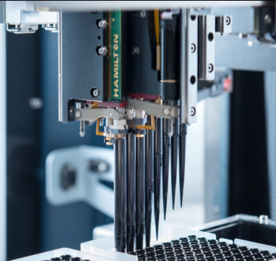



Summary and Benefit
Pathology System
Order Management System
LIMS
Multiple Applications
Redundant information entry
Distributed Business Logic
Notes:
In the As-Is process the lab technicians have to use multiple UI from multiple applications, copying sometimes data in between systems and manually proceed with the process through user tasks.
In this application based architecture the business logic is distributed in each system and coded. The distribution of business logic makes workflow changes complex and time consuming. Nobody has an overview of the whole process. It is not easy to check where a process is atm.

Slide 12
UI
Workflow Engine
API Layer
Pathology System
Order Management System
LIMS
Modern Architecture
Separated Business Logic
API Layer
Encapsulated Applications
User tasks simplify workflow steps
Improve collaboration between teams for process optimization
Notes:
With an workflow engine approach the businesslogic is centralized in one component that orchestrates the other systems. This reduces the complexity in each system as the business logic gets removed. The system do only need to provide an API Layer to communicate with the workflow engine. The whole lab process is documented and implement in the workflow engine. This could also improve documentation between lab and IT. IT changes are further decapsulated from business workflow, further reducing administrative overhead such as changing workflow if technical changes are made in the backend systems. The lab personell further benefits by having reduced user tasks and all user tasks are done in one and the same UI freeing up ime for the core work in the lab.

Slide 13

Thank you for your attention! 🍨

Slide 14
Sources
Link to this presentation: Vorlage_Praesentation_IEC.pptx
Google Sheets image: https://miro.medium.com/v2/resize:fit:4800/format:webp/1*pHglcoa-BSouiNT7R2p9yQ.png
Make image: https://www.omnitas.com/wp-content/uploads/2022/02/Make-Formerly-Integromat-Primary-Version-kvad.png
Make-Webhook image: https://www.esri.com/arcgis-blog/wp-content/uploads/2020/07/IntegromatWebhookEmail.png
Deepnote image: https://www.datanami.com/wp-content/uploads/2022/01/deepnote_logo_400x.png
Python image: https://www.python.org/static/opengraph-icon-200x200.png
Camunda image: https://camunda.com/wp-content/uploads/2020/07/camunda-logo-social-update.jpg

Slide 15
As is:
Backup Slides

Slide 16



Architecture
API-Call
HTTP-Request
API-Call
publish
Topic
subscribe
External Task
Notes:
- Center of our tobe-process is the registeration and check of incoming sample
- Process steps are triggered by the arival of the physical sample
- Bevor it gets checked against SOP criteria it needs to be registered
- Registration is done in LIMS and OrderManagementSystem via an API
- 2 APIs built which sends data over http-request to webhook which runs inside make
- Data get send as JSON and passed from webhook to Database (Google Sheet) via api call
-After Registeration the samples need to be checked, therefore we develop 2 process steps
- Check Sample gets the SampleType and provides it to a camunda form.
- The Form is build dynamically and only shows the SOP criterias which are related to the incoming sample type
- After the answers are inserted and the Form is dispatched, all of the values are passed to the step „calc result“
- This step will publish the data under a certain topic which is subscribed by an external task
- The task is written in python and runs on deepnote. It focuses on the calculation of the final result if the sample is ok or not.
- the result gets then passed to the gateway, which decides wether the sample is ok and can proceed to the analytics or if the order needs to be aborted

Slide 17
Presentation Outline, 10min
Intro: Background, Project
As is: Process, Problems
To Be: Process Big, Process Project Focus, Videos
Summary: How (Camunda as Orchestrator/Coordinator)

Slide 18
Durch Bild oder Grafik
ersetzen
(Grösse und Position beibehalten)

